Slide 1
LOAN RISK DETECTION
Unlocking Insights, Patterns and Anomalies
Within Financial Data

Slide 2
CONTENT
Problem Statement
Objective
Tools Used
Approaches
Insights
Model Building & Evaluation
Conclusion

Slide 3
PROBLEM STATEMENT
The consumer finance industry faces the challenge of accurately assessing creditworthiness, especially for applicants with limited or no credit history. Loan defaults present significant financial risks to lending institutions, highlighting the need for precise risk assessment methods. The objective of this project is to leverage Exploratory Data Analysis (EDA) and machine learning techniques to predict loan defaults effectively.

Slide 4
OBJECTIVE
Identify patterns and factors within historical loan application data that indicate a client's likelihood of defaulting on their loan payments.
Develop machine learning models to analyze demographic, financial, and credit-related factors influencing loan default.
Utilize insights from the analysis to inform port risk assessment, and lending practices.
Implement strategies to minimize financial losses due to loan defaults and optimize lending decisions.

Slide 5
TOOLS USED
Data Analysis and Preprocessing
Pandas: For data manipulation, cleaning, and preprocessing.
NumPy: For numerical operations and array manipulations.
SciPy: For scientific computing and statistical analysis.
scikit-learn: For machine learning algorithms and tools for data mining and data analysis.

Slide 6
Data Visualization
Matplotlib: For creating static, interactive, and animated visualizations.
Seaborn: For statistical data visualization based on Matplotlib.
Presentation
Jupyter Notebooks: For creating and sharing documents containing live code, equations, visualizations, and narrative text.

Slide 7
Model Building and Evaluation
scikit-learn: For implementing machine learning algorithms, model selection, and evaluation metrics.
Random Forest Classifier: For random forest algorithms that often perform well in financial risk prediction tasks.

Slide 8
APPROACHES
Data Collection
Gathered data from two sources: "application_data.csv" and "previous_application.csv".
These datasets contain relevant information about loan applications and previous financial informations..
Collected data includes features such as applicant demographics, financial information, credit history, and loan details.

Slide 9
Preprocessing
Performed data preprocessing to clean and prepare the datasets for analysis.
Handled missing values, outliers, and inconsistencies in the data.
Conducted data normalization and scaling to ensure uniformity across features.
Encoded categorical variables using techniques like one-hot encoding or label encoding for compatibility with machine learning algorithms.

Slide 10
Exploratory Data Analysis (EDA)
Utilized exploratory data analysis techniques to gain insights into the data.
Conducted statistical analysis, visualization, and summarization of key features.
Explored relationships between variables and identified potential patterns or trends.
Visualized distributions, correlations, and anomalies in the data to inform subsequent modeling steps.

Slide 11
Insights and Interpretation
Extracted meaningful insights from the EDA process to inform decision-making.
Identified important features and factors influencing loan default risk.
Analyzed the impact of demographic, financial, and credit-related variables on loan repayment behavior.
Interpreted visualization findings to understand the underlying patterns and relationships in the data.

Slide 12
Machine Learning Model - Random Forest Classifier
Developed a predictive model using the Random Forest Classifier algorithm.
Random Forest is chosen for its ability to handle complex datasets and provide accurate predictions.
Trained the model using the preprocessed dataset to learn patterns associated with loan default.

Slide 13
EDA INSIGHTS
Client Profile Analysis
1. Demographic Analysis Code Gender– F(0.053068), M(0.068934)
2. Default rates based on Educational level – Lowest Secondary has the highest rate with 0.087514
3. Default rates based on Employment level – waiters/ barmen staff has the highest rate when compared to others.
4. Income Distribution of Default vs. Non-Default Clients – Non-Default has the highest value.

Slide 14
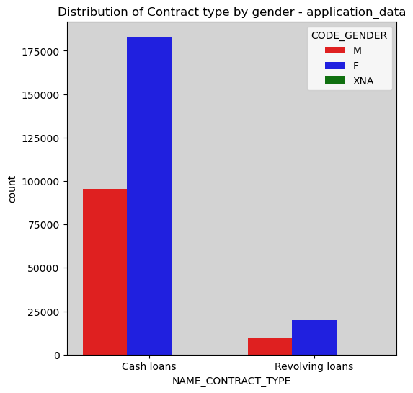
DISTRIBUTION OF CONTRACT TYPE BY GENDER

Slide 15
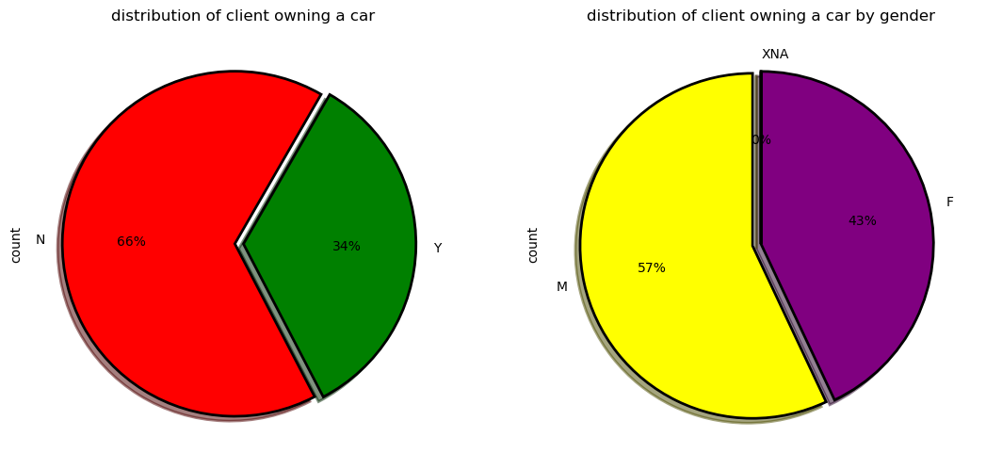
DISTRIBUTION OF CAR OWNING BY GENDER

Slide 16
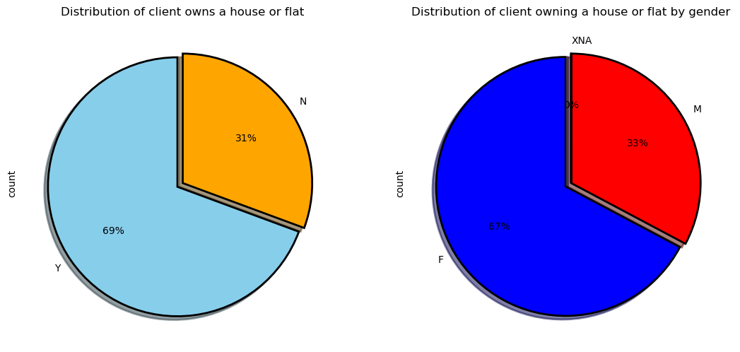
DISTRIBUTION OF OWN HOUSE BY GENDER

Slide 17
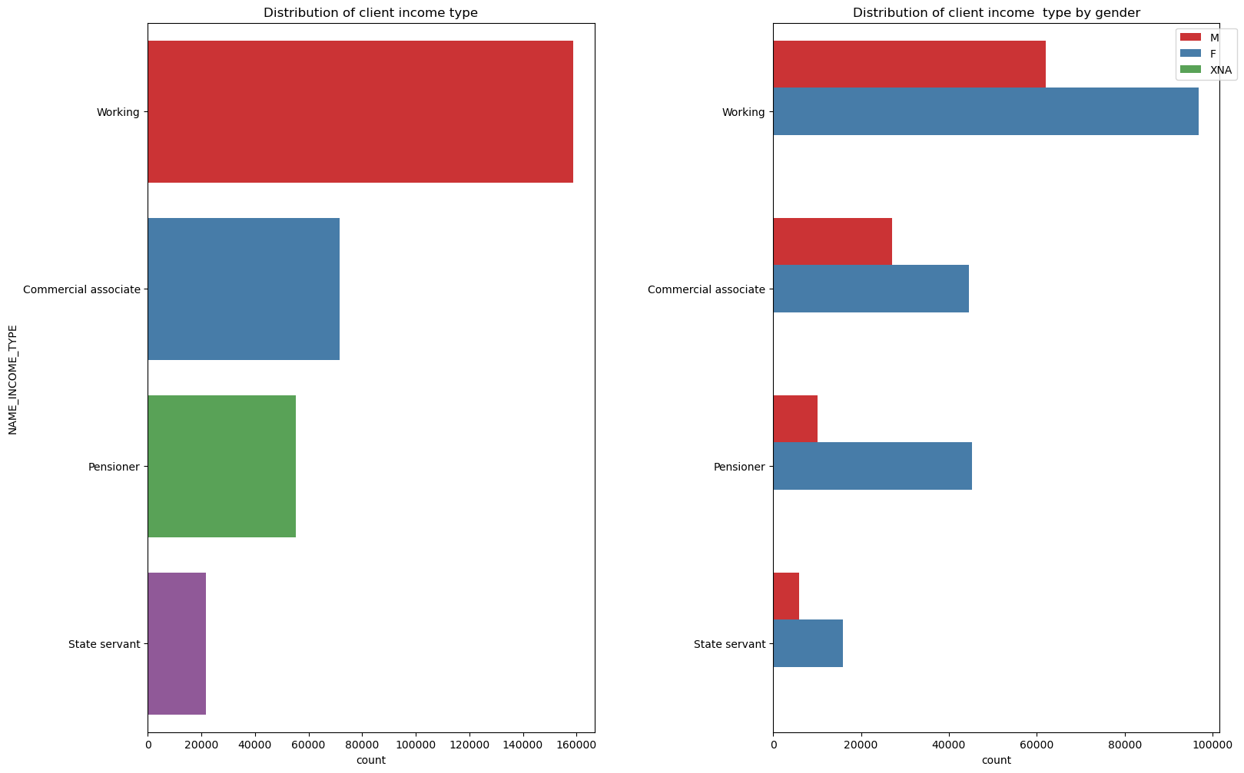
CLIENT INCOME TYPE & BY GENDER

Slide 18
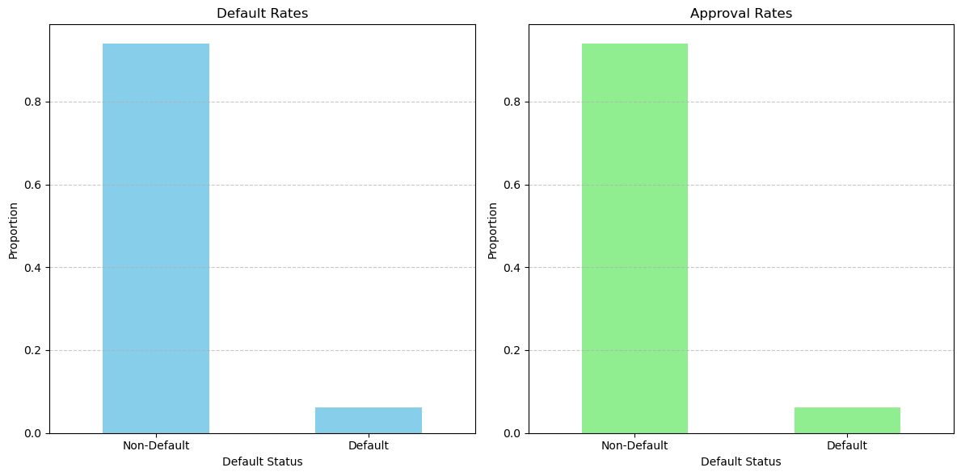
Financial Analysis
1. Default Rates Vs. Approval Rates

Slide 19
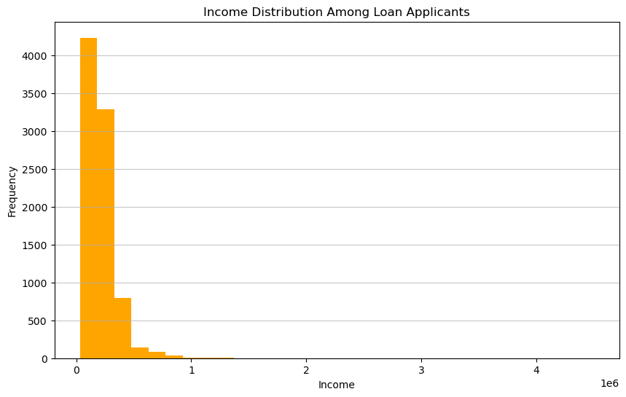
2. Income distribution among loan applicants

Slide 20
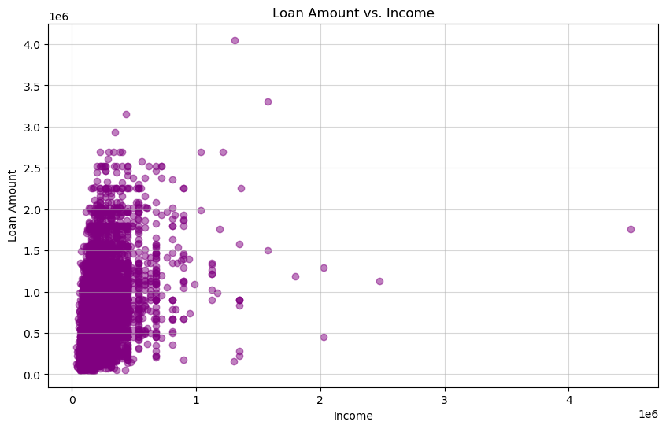
3. Relationship between loan amount and income

Slide 21
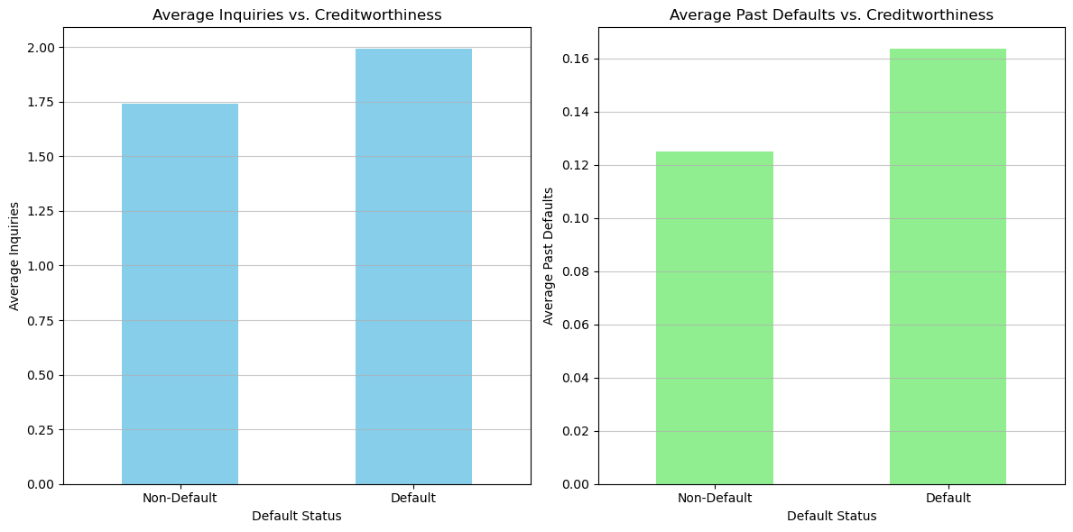
Credit History Analysis
1. Relationship between number of inquiries and past defaults

Slide 22
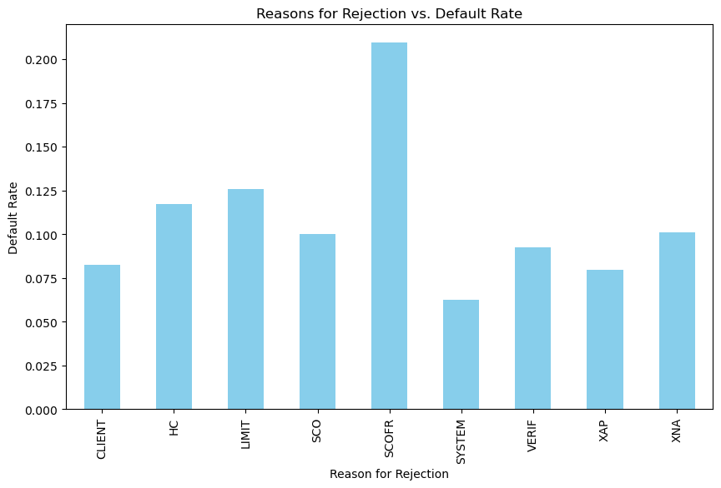
2. Relationships between credit risk and reasons for rejection

Slide 23
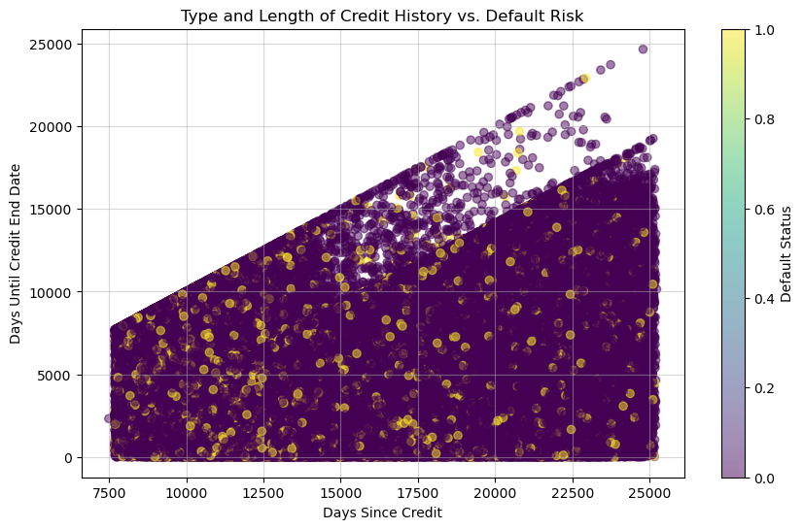
3. Relationship between type and length of credit history and default risk

Slide 24
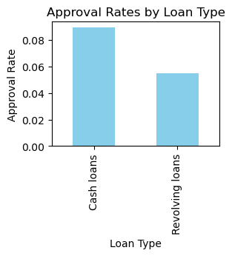
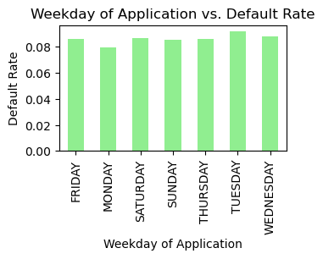
Loan Application Decisions Analysis
1. Approval Rates by Loan Type
2. Weekday of Application vs. Default Rate

Slide 25
MODEL BUILDING & EVALUATION
0.003223856538384042
In this project, I implemented a Random Forest Classifier as machine learning approach to detect financial risk in loan applications. Random Forest is a powerful ensemble learning algorithm known for its effectiveness in classification tasks, making it well-suited for risk prediction in consumer finance and larger dataset. It gives the accuracy of 0.91% . With the values of precision, recall and F1 score as 0.5714285714285714, 0.0016164881794301878 and 0.003223856538384042.

Slide 26
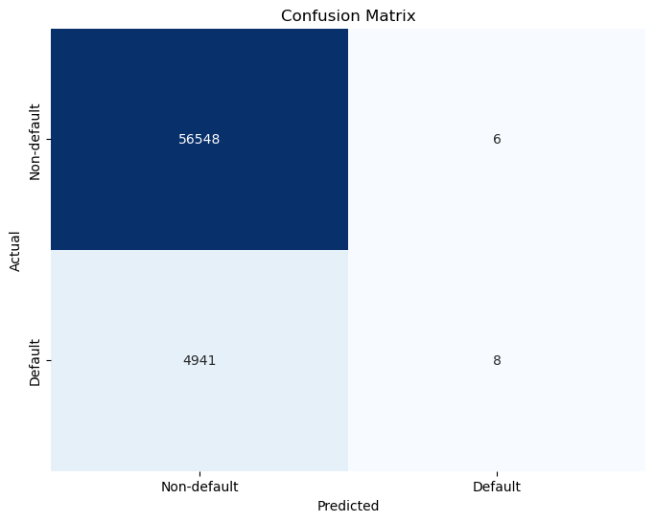
CONFUSION MATRIX

Slide 27
CONCLUSION
In conclusion, the financial risk detection project utilizing machine learning techniques, specifically the Random Forest Classifier, has demonstrated significant potential in improving risk assessment processes for lending institutions. Through meticulous data preprocessing, model implementation, and comprehensive evaluation, we have achieved notable insights and outcomes like Enhanced Risk assessment, Insights & Understandings and Operational Efficiency.

Slide 28
THANK YOU

